Slide 1

Recipe finder
Morgan Du Bois, Jakob Hoveland, Anna Rowena Waldron

Slide 2

The business problem
An easier solution to finding recipes

Slide 3


The Business Problem
Customers want the ability to find recipes using ingredients they already have at home
Customers want the ability to see if an item is available at their local grocery store before making the trip
Customers want to easily refer to their favorite recipes

Slide 4
The schema
Database layout

Slide 5
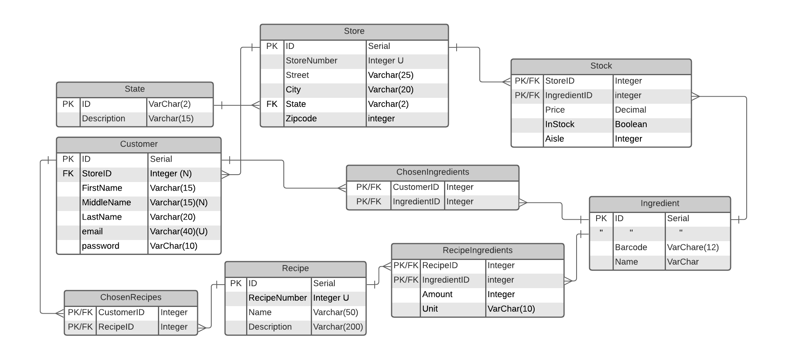

Slide 6
Demo
Application showcase

